Slide 1

CheckM2 & dRep
Derya Aytan-Aktug

Slide 2
What have you done so far?
Sample
Sequencing
Assembling
Binning

Slide 3
Quality of bins?
Contaminated?
Complete?

Slide 4
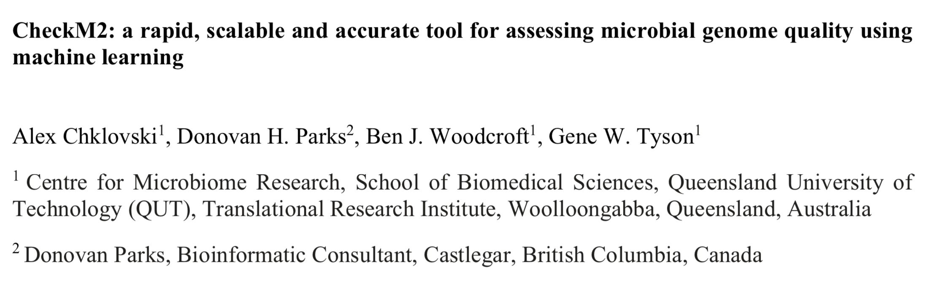
Quality of bins?
Contaminated?
Complete?
CheckM2

Slide 5
CheckM2
Machine learning based tool
Gradient boosting trees
Neural Networks
Training dataset
Simulated MAGs
Genome length
Number of coding sequences
Amino acid counts
Annotated proteins
Notes:
48 Here we introduce CheckM2, a machine learning-based tool for predicting isolate, single-cell and
49 MAG quality. CheckM2 builds models suitable for predicting bacterial and archaeal genome
50 completeness and contamination without explicitly considering taxonomic information. CheckM2
51 was trained on simulated genomes with known levels of completeness and contamination,
52 benchmarked, and subsequently applied to MAGs from a range of different environments. Overall,
53 CheckM2 outperformed CheckM1, and performed substantially better on MAGs from novel
54 lineages, such as the Candidate Phyla Radiation (Patescibacteria) and DPANN superphylum, as
55 well as other lineages with sparse or no genomic representation.

Slide 6
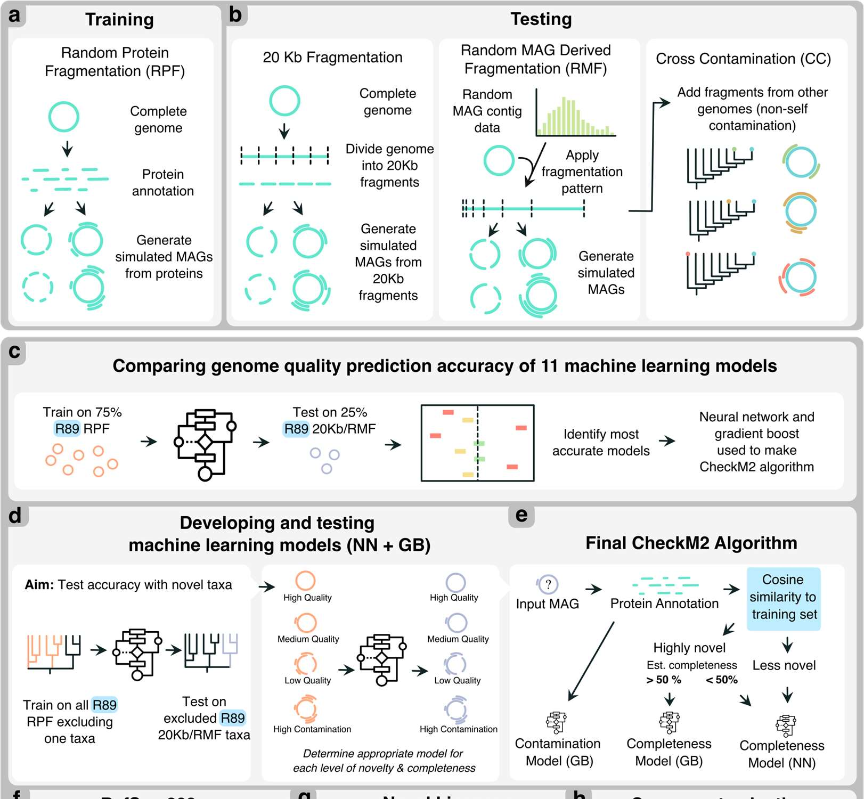

Slide 7
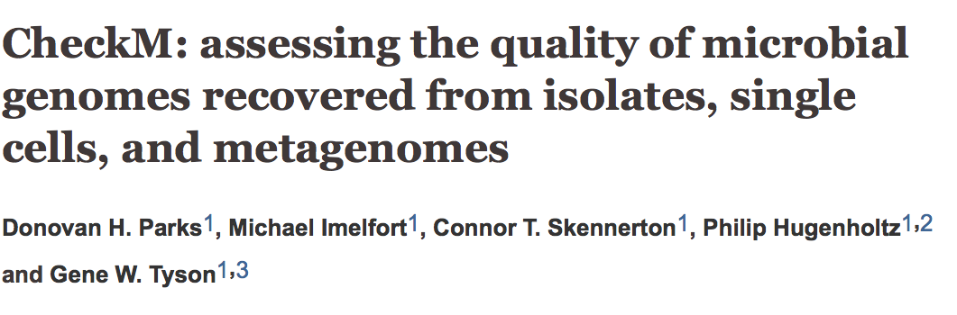
What was wrong with CheckM1?
Identification of single copy genes
Presence/absence and copy number
Works well with the well studied lineages
But, not very accurate for the novel lineages

Slide 8
What are high quality and medium quality bins?
High quality bins
>90% completeness, <5% contamination
Medium quality bins
50%-90% completeness, <10% contamination
Low quality bins
<50% completeness, <10% contamination
Highly contaminated bins
>10% contamination

Slide 9
How can we run CheckM2?
Load checkm2/20220719
Module load tools checkm2/20220719
Install database for the protein annotation part (already done for you):
checkm2 database --download --path /to/your/dir/
Point your database (add that into your PBS script):
CHECKM2DB=/home/projects/co_23260/data/databases/CheckM2_database/uniref100.KO.1.dmnd
Run CheckM2 via PBS:
checkm2 predict --threads 20 --input /path/to/bins/ --output-directory /path/to/checkm2_res -x .fa --force

Slide 10
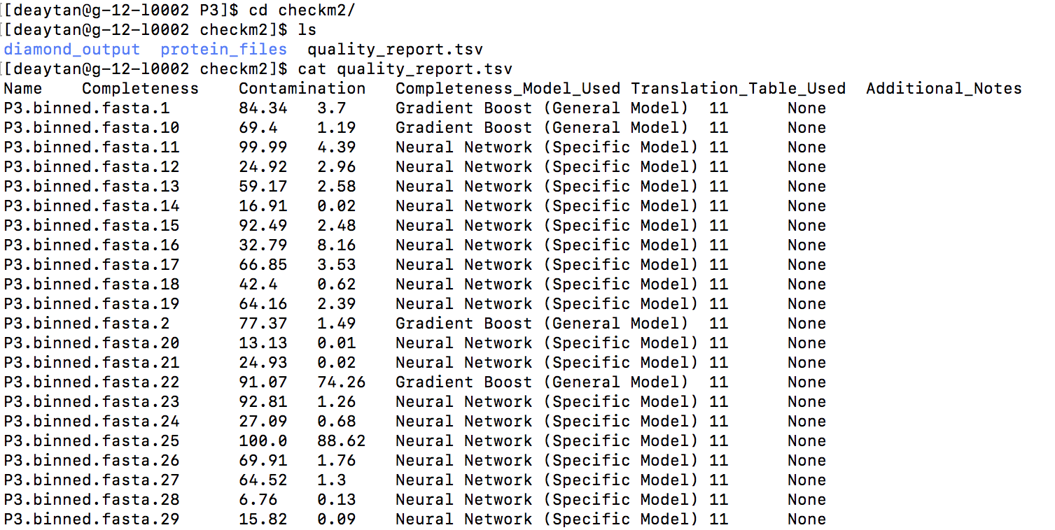
Expected output

Slide 11
Genome comparisons and dereplication
Many MAGs could be nearly identical
dRep
Compare
Which MAGs are very similar?
Dereplicate
Find the best representative for the similar bins
More complete, less contaminated

Slide 12
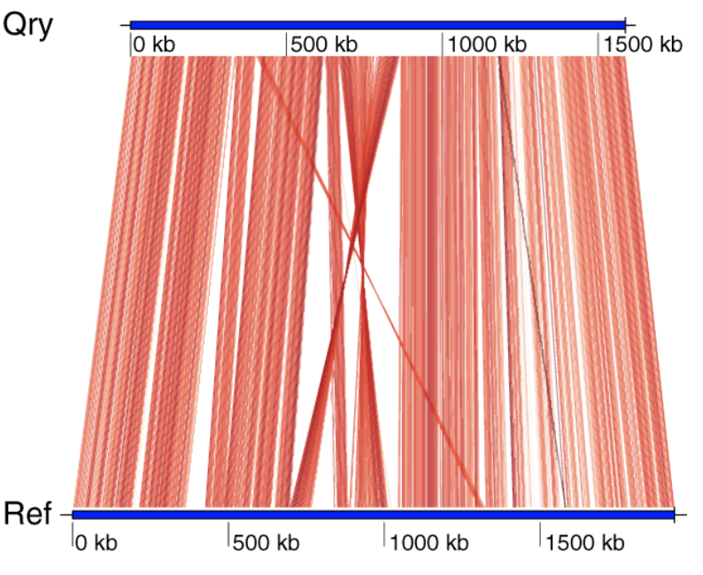
How dRep works?
It detects the similarity between MAGs using ANI
ANI: Mean nucleotide identity of gene pairs shared between two genomes

Slide 13
How dRep works?
Primary clustering
Fast but less sensitive
Mash distances
Prone to incompleteness
Consider only high and medium quality bins

Slide 14
Primary clustering

Slide 15
Primary clustering

Slide 16
How dRep works?
Primary clustering
Fast but less sensitive
Mash distances
Prone to incompleteness
Secondary clustering
Computationally intense and sensitive
Sensitive ANI algorithms (ANIn, ANImf, gANI, fastANI)
Robust against incompleteness
Cannot handle large genome lists
Consider only high and medium quality bins
Notes:
ANIn (Richter 2009). This aligns whole genomes with nucmer and compares the aligned regions.
ANImf (DEFAULT). This is the same as ANIn, but filters the alignments such that each region of genome 1 and only align to a single region of genome 2. This takes slightly more time, but is much more accurate on genomes with repeat regions
gANI (Varghese 2015). This aligns genes (ORFs) called by Prodigal instead of aligning whole genomes. This algorithm is a bit faster than ANIm-based algorithms, but only aligns coding regions.
goANI. This is my own open-source implementation of gANI, which is not open source (and for which the authors would not share the source code when asked). I wrote this algorithm so that I could calculate dN/dS between aligned genes for this study (you can too using dnds_from_drep.py). Requires the program NSimScan.
FastANI (Jain 2018). A really fast Mash-based algorithm that can also handle incomplete genomes. Seems to be just as accurate as alignment-based algorithms. Should probably be the default algorithm when you care about runtime.*

Slide 17
Secondary clustering
Notes:
most studies agree that 95% ANI is an appropriate threshold for species-level de-replication.
If the goal of dereplication is to generate a set of genomes that are distinct when mapping short reads, 98% ANI is an appropriate threshold.

Slide 18
Secondary clustering
Remember!
Only dereplicate option will provide the best representative genomes.
Compare option will only compare the genomes to each other

Slide 19
How dRep determines the best representative genomes?
=𝐴∗𝐶𝑜𝑚𝑝𝑙𝑒𝑡𝑒𝑛𝑒𝑠𝑠−𝐵∗𝐶𝑜𝑛𝑡𝑎𝑚𝑖𝑛𝑎𝑡𝑖𝑜𝑛+
𝐶∗(𝐶𝑜𝑛𝑡𝑎𝑚𝑖𝑛𝑎𝑡𝑖𝑜𝑛∗(𝑠𝑡𝑟𝑎𝑖𝑛ℎ𝑒𝑡𝑒𝑟𝑜𝑔𝑒𝑛𝑒𝑖𝑡𝑦/100))+𝐷∗𝑙𝑜𝑔(𝑁50)+
𝐸∗𝑙𝑜𝑔(𝑠𝑖𝑧𝑒)+𝐹∗(𝑐𝑒𝑛𝑡𝑟𝑎𝑙𝑖𝑡𝑦−𝑆_{𝑎}𝑛𝑖)
Notes:
Where A-F are command-line arguments with default values of 1, 5, 1, 0.5, 0, and 1, respectively.
Completeness, Contamination, and strain heterogeneity are provided by the user or calculated with checkM. N50 is a measure of how big the pieces are that make up the genome. size is the total length of the genome. Centrality is a measure of how similar a genome is to all other genomes in it’s cluster. This metric helps pick genome that are similar to all other genomes, and avoid picking genomes that are relative outliers.

Slide 20
When to dereplicate?
Redundancy in MAGs
Could be problematic in downstream analyses
Mapping reads back to MAGs
Multiple high quality alignments

Slide 21
When to dereplicate?
Redundancy in MAGs
Could be problematic in downstream analyses
Mapping reads back to MAGs
Multiple high quality alignments
Read
MAG-1
MAG-2
Notes:
Better percentage of mapping

Slide 22
When to dereplicate?
Redundancy in MAGs
Could be problematic in downstream analyses
Mapping reads back to MAGs
Multiple high quality alignments
Read
MAG-1
MAG-2

Slide 23
When not to dereplicate?
Removing closely related genomes is not ideal when interested in:
Single nucleotide variations
MAG-1
MAG-2
Notes:
Auxiliary genes are such genes with high similarity to host homologues

Slide 24
How to dereplicate genomes using dRep?
Load relevant modules
Module load tools anaconda3/4.4.0 mash/2.3 fastani/1.33 prodigal/2.6.3
Run dRep via PBS:
dRep dereplicate /path/to/outdir/ -g /path/to/genomes/*.fa --genomeInfo /path/to/CheckM2/edited_quality_report.txt –pa 0.9 –sa 0.97

Slide 25
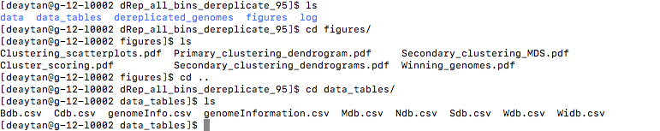
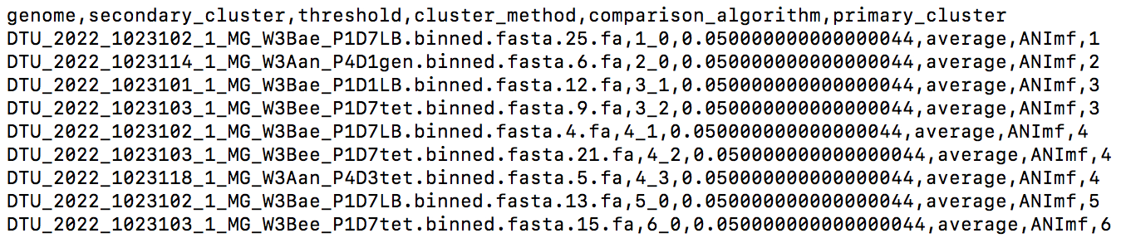
Expected output

Slide 26
Today’s assignments:
https://learn.inside.dtu.dk/d2l/le/content/126041/Home

